Slide 1
Code Generation
BY
ABHISHEK[RA2011033010069]
AMITABH MISHRA[RA2011033010072]

Slide 2
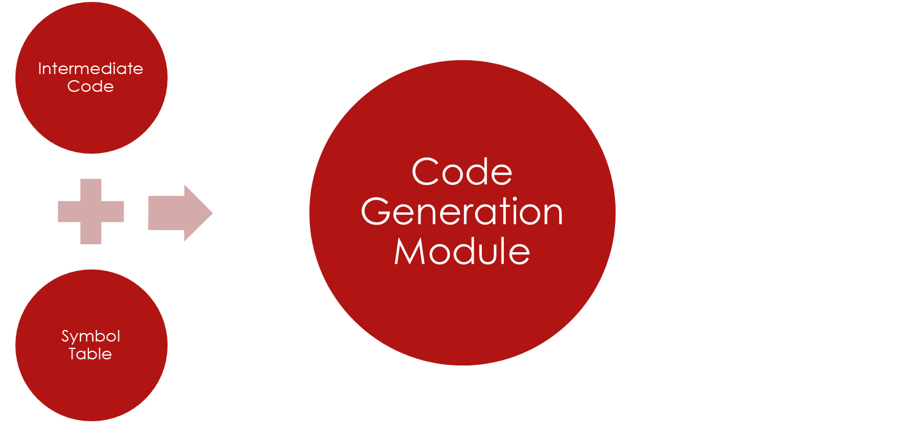


Target
Machine
Code

Slide 3
Pre-requisites
Instruction set of target machine.
Instruction addressing modes.
No. of registers.
Configuration of ALU

Slide 4
Instruction set
Load/Store operations:
op dest, src
Eg. :
Load R0, X
Store X, R0
Arithmetic/ Logical operations:
op dest, src1, src2
Eg.:
ADD R0, R1, R2
ADD R0, R1, M
where M corresponds to a memory location.
Control operations:
Unconditional Branch:
brn L
Conditional branch:
BGTZ x L

Slide 5
Addressing Modes
Register addressing mode
Indirect addressing mode
Index addressing mode
Eg.: a[i]
Immediate addressing mode
Eg,: add R1, R2, 100

Slide 6
Issues in the design of a code generator
Memory management
Target programs
Instruction selection
Register allocation
Evaluation order

Slide 7
Memory Management
Mapping names in the source program to addresses of data objects in run-time memory is done cooperatively by the front end and the code generator.
A name in a three- address statement refers to a symbol-table entry for the name.
From the symbol-table information, a relative address can be determined for the name in a data area for the procedure.

Slide 8
Target Programs
Absolute machine language:
Producing an absolute machine language program as output has the advantage that it can be placed in a fixed location in memory and immediately executed.
Relocatable machine language:
  Producing a relocatable machine language program as output allows subprograms to be compiled separately. A set of relocatable object modules can be linked together and loaded for execution by a linking loader. If the target machine does not handle relocation automatically, the compiler must provide explicit relocation information to the loader, to link the separately compiled program segments.
Assembly language:
Producing an assembly language program as output makes the process of code generation some what easier.

Slide 9
Instruction Selection
The factors to be considered during instruction selection are:
  The uniformity and completeness of the instruction set.
  Instruction speed and machine idioms.
  Size of the instruction set.
Eg., for the following address code is:
a := b + c
d := a + e
inefficient assembly code is:
MOV b, R₀ R₀ ← b
ADD c, R₀ R₀ ← c + R₀
MOV R₀, a a ← R₀
MOV a, R₀ R₀ ← a
ADD e, R₀ R₀ ← e + R₀
MOV R₀ , d d ← R₀
Here the fourth statement is redundant, and so is the third statement if
'a' is not subsequently used.

Slide 10
Register Allocation
Instructions involving register operands are usually shorter and faster than those involving operands in memory. Therefore efficient utilization of registers is particularly important in generating good code.
During register allocation we select the set of variables that will reside in registers at each point in the program.
During a subsequent register assignment phase, we pick the specific register that a variable will reside in.

Slide 11
Evaluation Order
The order in which computations are performed can affect the efficiency of the target code.
Some computation orders require fewer registers to hold intermediate results than others.

Slide 12
Basic Blocks and Control Flow Graphs
A basic block is the longest sequence of three-address codes with the following properties.
  The control ﬂows to the block only through the ﬁrst three-address code.
  The ﬂow goes out of the block only through the last three-address code.
A control-ﬂow graph is a directed graph G = (V,E), where the nodes are the basic blocks and the edges correspond to the ﬂow of control from one basic block to another. As an example the edge eij = (vi , vj) corresponds to the transfer of ﬂow from the basic block vi to the basic block vj.

Slide 13
Code Generation Algorithm
Computing Next-Use Information
Knowing when the value of a variable will be used next is essential for generating good code.
If there is a three-address instruction sequence of the form
i: x = y + z
.
. no assignments to x between instructions i and j
.
j: a = x + b
then we say statement j uses the value of x computed at i.
We also say that variable x is live at statement i.
A simple way to find next uses is to scan backward from the end of a basic block keeping track for each name x whether x has a next use in the block and if not whether x is live on exit from that block.

Slide 14
Code Generation Algorithm
Here we describe an algorithm for generating code for a basic block that keeps track of what values are in registers so it can avoid generating unnecessary loads and stores.
  It uses a register descriptor to keep track of what variable values are in each available register.
  It uses an address descriptor to keep track of the location or locations where the current value of each variable can be found.
  For the instruction x = y + z it generates code as follows:
    It calls a function getReg(x = y + z) to select registers Rx, Ry, and Rz for variables x, y, and z.
    If y is not in Ry, it issues the load instruction LD Ry, My where My is one of the memory locations for y in the address descriptor.
    Similarly, if z is not in Rz, it issues a load instruction LD Rz, Mz.
    It then issues the instruction ADD Rx, Ry, Rz.

Slide 15
Code Generation Algorithm
  For the instruction x = y it generates code as follows:
    It calls a function getReg(x = y) to select a register Ry for both x and y. We assume retReg will always choose the same register for both x and y.
    If y is not in Ry, issue the load instruction LD Ry, My where My is one of the memory locations for y in the address descriptor.
    If y is already in Ry, we issue no instruction.
  At the end of the basic block, it issues a store instruction ST x, R for every variable x that is live on exit from the block and whose current value resides only in a register R.
  The register and address descriptors are updated appropriately as each machine instruction is issued.
  If there are no empty registers and a register is needed, the function getReg generates a store instruction ST v, R to store the value of the variable v in some occupied register R. Such a store is called a spill. There are a number of heuristics to choose the register to spill.

